Slide 1
Industrial Processes
The two processes that we will be looking at are:
The Haber Process (production of ammonia)
The Contact Process (production of sulfuric acid)
Notes:
In the chemical industry, the careful control of factors affecting reaction rate and equilibrium concentrations plays a vital role in achieving profitable production methods.
Chemists use sneaky methods to devise a combination of reaction processes and conditions that produce the maximum amount of desired product for minimum cost.
In addition, the production methods they devise must take into account important issues such as safety and environmental considerations.

Slide 2

What would you do?
If you were the chief chemical engineer or chemist, what would you suggest would be the best way to
maximise the yield?
Notes:
Increase temperature
Increase pressure (decrease volume)
Increase concentration of one of the reactants (keeping in mind which one is the LR for the reaction)
Use a catalyst
We would want to consider reaction rate as this determines how quickly the products are produced.
We would want to consider the yield of products formed at chemical equilibrium. We can then manipulate the factors that affect CE to increase the yield.

Slide 3
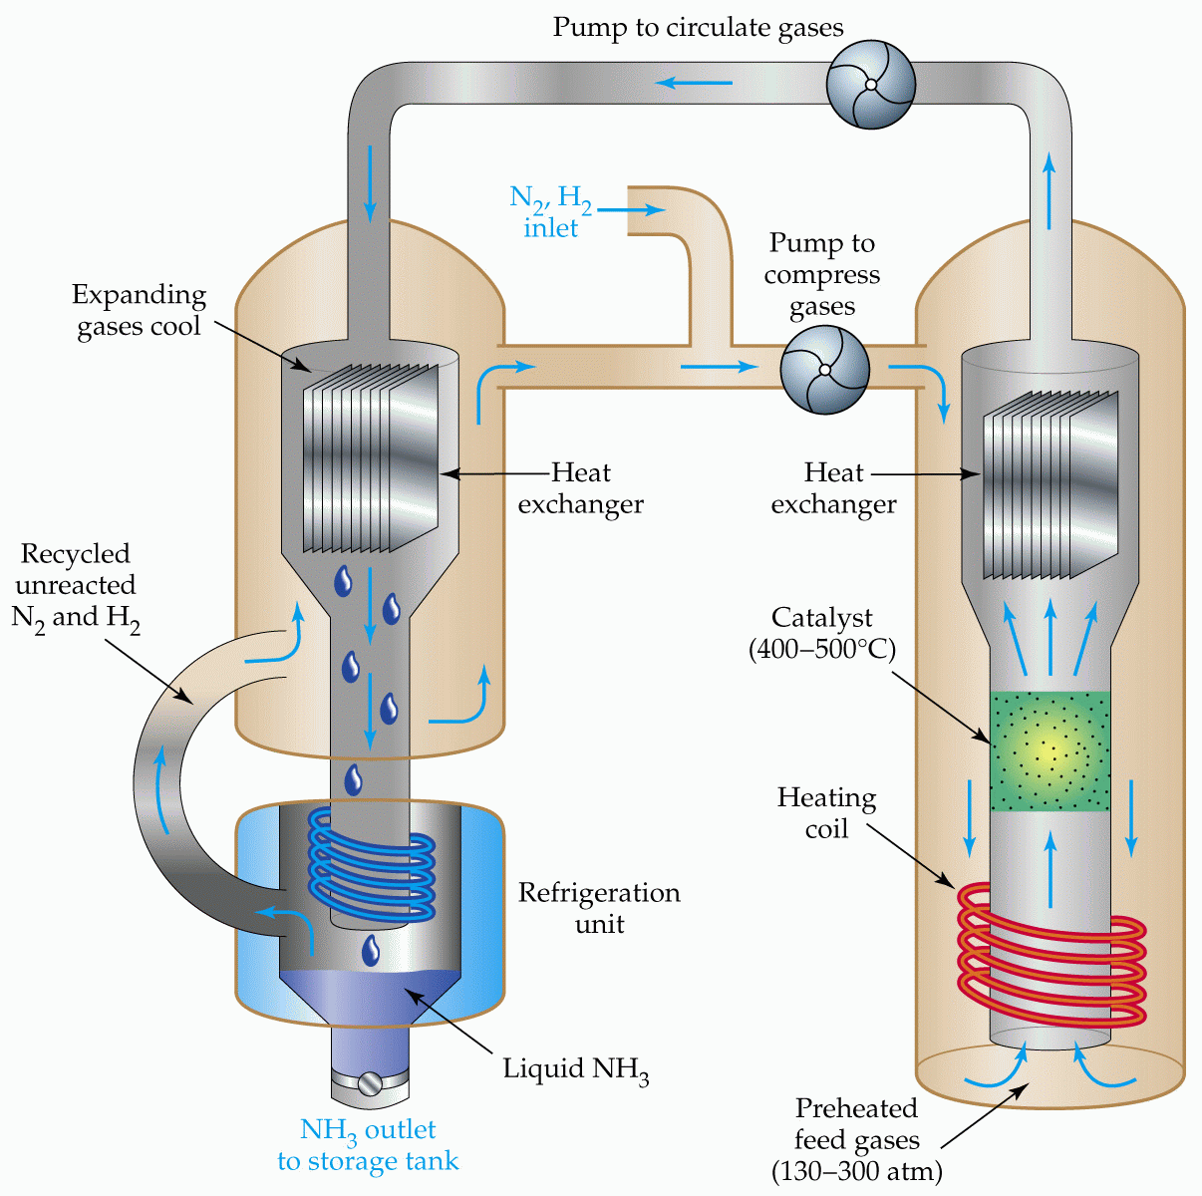
Haber Process

Slide 4

Historically…
Shortage of naturally occurring nitrogen
German Chemist Fritz Haber et al sought to combine nitrogen and hydrogen
German chemical industry also interested due to the applications in WW2
Notes:
At the beginning of the 20th century there was a shortage of naturally occurring, nitrogen-rich fertilizers This prompted the German Chemist Fritz Haber, and others, to look for ways of combining the nitrogen in the air with hydrogen to form ammonia, which is a convenient starting point in the manufacture of fertilizers. This process was also of interest to the German chemical industry as Germany was preparing for World War I and nitrogen compounds were needed for explosives.

Slide 5
Important uses of Ammonia and its Compounds
MAKING
FERTILISERS 80% of the ammonia produced goes to make fertilisers such as
ammonium nitrate (NITRAM) and ammonium sulphate
NH₃ + HNO₃ ——> NH₄NO₃
2NH₃ + H₂SO₄ ——> (NH₄)₂SO₄
MAKING
NITRIC ACID ammonia can be oxidised to nitric acid
nitric acid is used to manufacture...
fertilisers (ammonium nitrate)
explosives (TNT)
polyamide polymers (NYLON)
Notes:
Why is ammonia so important?

Slide 6
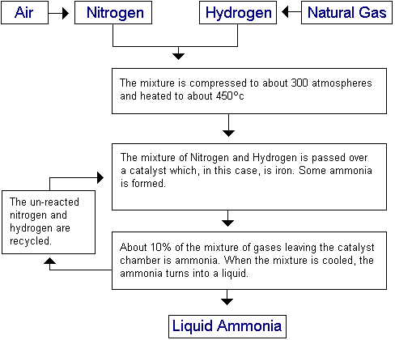
Flow Chart of the Haber Process
Notes:
Increase pressure
Increase temperature
Catalyst – iron
Remove liquid ammonia

Slide 7
Haber Process
N₂(g) + 3H₂(g) 2NH₃(g) H = - 92 kJ mol⁻¹
Conditions Pressure 20000 kPa (200 atmospheres)
Temperature 380-450°C
Catalyst iron oxide

Slide 8
Haber Process
N₂(g) + 3H₂(g) 2NH₃(g) H = - 92 kJ mol⁻¹
Conditions Pressure 20000 kPa (200 atmospheres)
Temperature 380-450°C
Catalyst iron oxide
Equilibrium theory favours
low temperature exothermic reaction - higher yield at lower temperature
high pressure decrease in number of gaseous molecules
Notes:
Exothermic… releases heat
Temperature
This is actually a low temp!!!! Decreasing the temperature causes the equilibrium position to move to the right resulting in a higher yield of ammonia since the reaction is exothermic (releases heat). Reducing the temperature means the system will adjust to minimise the effect of the change, that is, it will produce more heat since energy is a product of the reaction, and will therefore produce more ammonia gas as well However, the rate of the reaction at lower temperatures is extremely slow, so a higher temperature must be used to speed up the reaction which results in a lower yield of ammonia.
Effect on RR?
Pressure
Increasing the pressure causes the equilibrium position to move to the right resulting in a higher yield of ammonia since there are more gas molecules on the left hand side of the equation (4 in total) than there are on the right hand side of the equation (2). Increasing the pressure means the system adjusts to reduce the effect of the change, that is, to reduce the pressure by having fewer gas molecules.

Slide 9
Haber Process
N₂(g) + 3H₂(g) 2NH₃(g) H = - 92 kJ mol⁻¹
Conditions Pressure 20000 kPa (200 atmospheres)
Temperature 380-450°C
Catalyst iron oxide
Equilibrium theory favours:
low temperature exothermic reaction - higher yield at lower temperature
high pressure decrease in number of gaseous molecules
Kinetic theory favours:
high temperature greater average energy + more frequent collisions
high pressure more frequent collisions for gaseous molecules
catalyst lower activation energy
Notes:
Rate considerations:
Increased temperature means more reactant molecules have sufficient energy to overcome the energy barrier to reacting (activation energy) so the reaction is faster at higher temperatures (but the yield of ammonia is lower as discussed above).
Problem! Decreasing temp decreases RR. So a compromise of a temp to to around 400ºC is required that enables a reasonable amount of product (10-20%) to be obtained at a satisfactory rate.
Increasing pressure also increases RR.
The reactant molecules are within a smaller space in which they have to react.
A catalyst such as an iron catalyst is used to speed up the reaction by lowering the activation energy so that the N₂ bonds and H₂ bonds can be more readily broken.

Slide 10
Haber Process
N₂(g) + 3H₂(g) 2NH₃(g) H = - 92 kJ mol⁻¹
Conditions Pressure 20000 kPa (200 atmospheres)
Temperature 380-450°C
Catalyst iron oxide
Equilibrium theory favours:
low temperature exothermic reaction - higher yield at lower temperature
high pressure decrease in number of gaseous molecules
Kinetic theory favours:
high temperature greater average energy + more frequent collisions
high pressure more frequent collisions for gaseous molecules
catalyst lower activation energy
Compromise conditions
Which is better? A low yield in a shorter time or
a high yield over a longer period.
Notes:
Overall:
By using a pressure of around 200atm and a temperature of about 500ºC, the yield of ammonia is 10-20%, while costs and safety concerns in the building and during operation of the plant are minimized.

Slide 11
The conditions used are a compromise with the catalyst
enabling the rate to be kept up, even at a relative lower temperature.

Slide 12
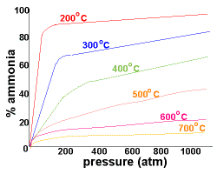

Slide 13
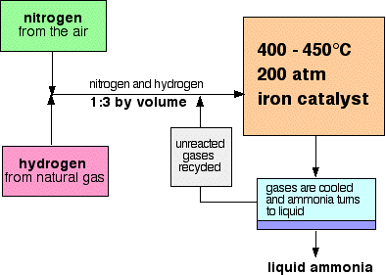
During industrial production of ammonia, the reaction never reaches equilibrium as the gas mixture leaving the reactor is cooled to liquefy and ammonia is removed.
The remaining mixture of reactant gases are recycled through the reactor. The heat released by the reaction is removed and used to heat the incoming gas mixture.

Slide 15
1. What does REVERSIBLE REACTION mean?
A reaction that can proceed in both directions

Slide 16
2 a. What does the Haber Process make ? b. Give one USE of this product.
Ammonia
To make fertilisers

Slide 17
3. There are THREE RAW MATERIALS for the Haber Process. What are they?
Nitrogen is easily obtained from air by fractional distillation
Hydrogen is obtained from methane reacted with steam.
methane + steam carbon dioxide + hydrogen. CH₄(g) + 2H₂O(g) CO₂(g) + 4H₂(g)
The raw materials are therefore: air - for nitrogen, methane and water - for hydrogen.

Slide 18
4. Write the BALANCED CHEMICAL EQUATION for the Haber Process.
nitrogen + hydrogen ammonia ( + heat)
N₂(g) + 3H₂(g) 2NH₃(g) ( + heat)

Slide 19
5. In a Reversible Reaction, how can the YIELD be Changed ?
Change the conditions (use of temperature, pressure and catalyst).
This is a useful summary for any reversible reaction including the Haber Process.
1. ↑ temperature favours the endothermic reaction.
2. ↑ pressure favours the smaller volume.
3. Using a catalyst gives the equilibrium conditions more quickly.

Slide 20
6. Why is the Haber Process run at 450 °C instead of room temperature?
To increase rate of reaction

Slide 21
7. Why is the Haber Process run at HIGH PRESSURE? Give two reasons.
Increasing the pressure (from LCP) makes the equilibrium mixture have more ammonia.
Increasing pressure also increases the reaction rate.

Slide 22
8. Why is the Haber Process not run at VERY HIGH PRESSURE?
Too expensive

Slide 23
9. Which substance is used as a CATALYST in the Haber Process?
Iron oxide catalyst

Slide 24
10. Use Le Chatalier Principle to explain what happens as a PRODUCT IS REMOVED…
If you remove a product, the equilibrium mixture changes to make more product. Ammonia bp -33degrees C.
It tries to get back to the composition it had before the product was removed.
You can carry on removing product until all the reactants have turned into product

Slide 25
11. Use LCP to explain what happens as HEAT IS REMOVED…
Heat may be treated as a reactant (for an endothermic reaction) or as a product (for an exothermic reaction).
If you remove heat from an exothermic reaction the equilibrium will change to produce more product.
If you add heat to an exothermic reaction (raise its temperature),the reverse will happen, and you will get less product in the equilibrium mixture.

Slide 26
12. What effect does a CATALYST have on the EQUILIBRIUM COMPOSITION?
No effect.
Equilibrium is just reached more quickly.

